Slide 1
What's up LOD Cloud Observing The State of Linked Open Data Cloud Metadata
Ahmad Assaf, Raphaël Troncy And Aline Senart
@ahmadaassaf
LDQ15 – 2nd Workshop on Linked Data Quality
1st June 2015

Slide 2
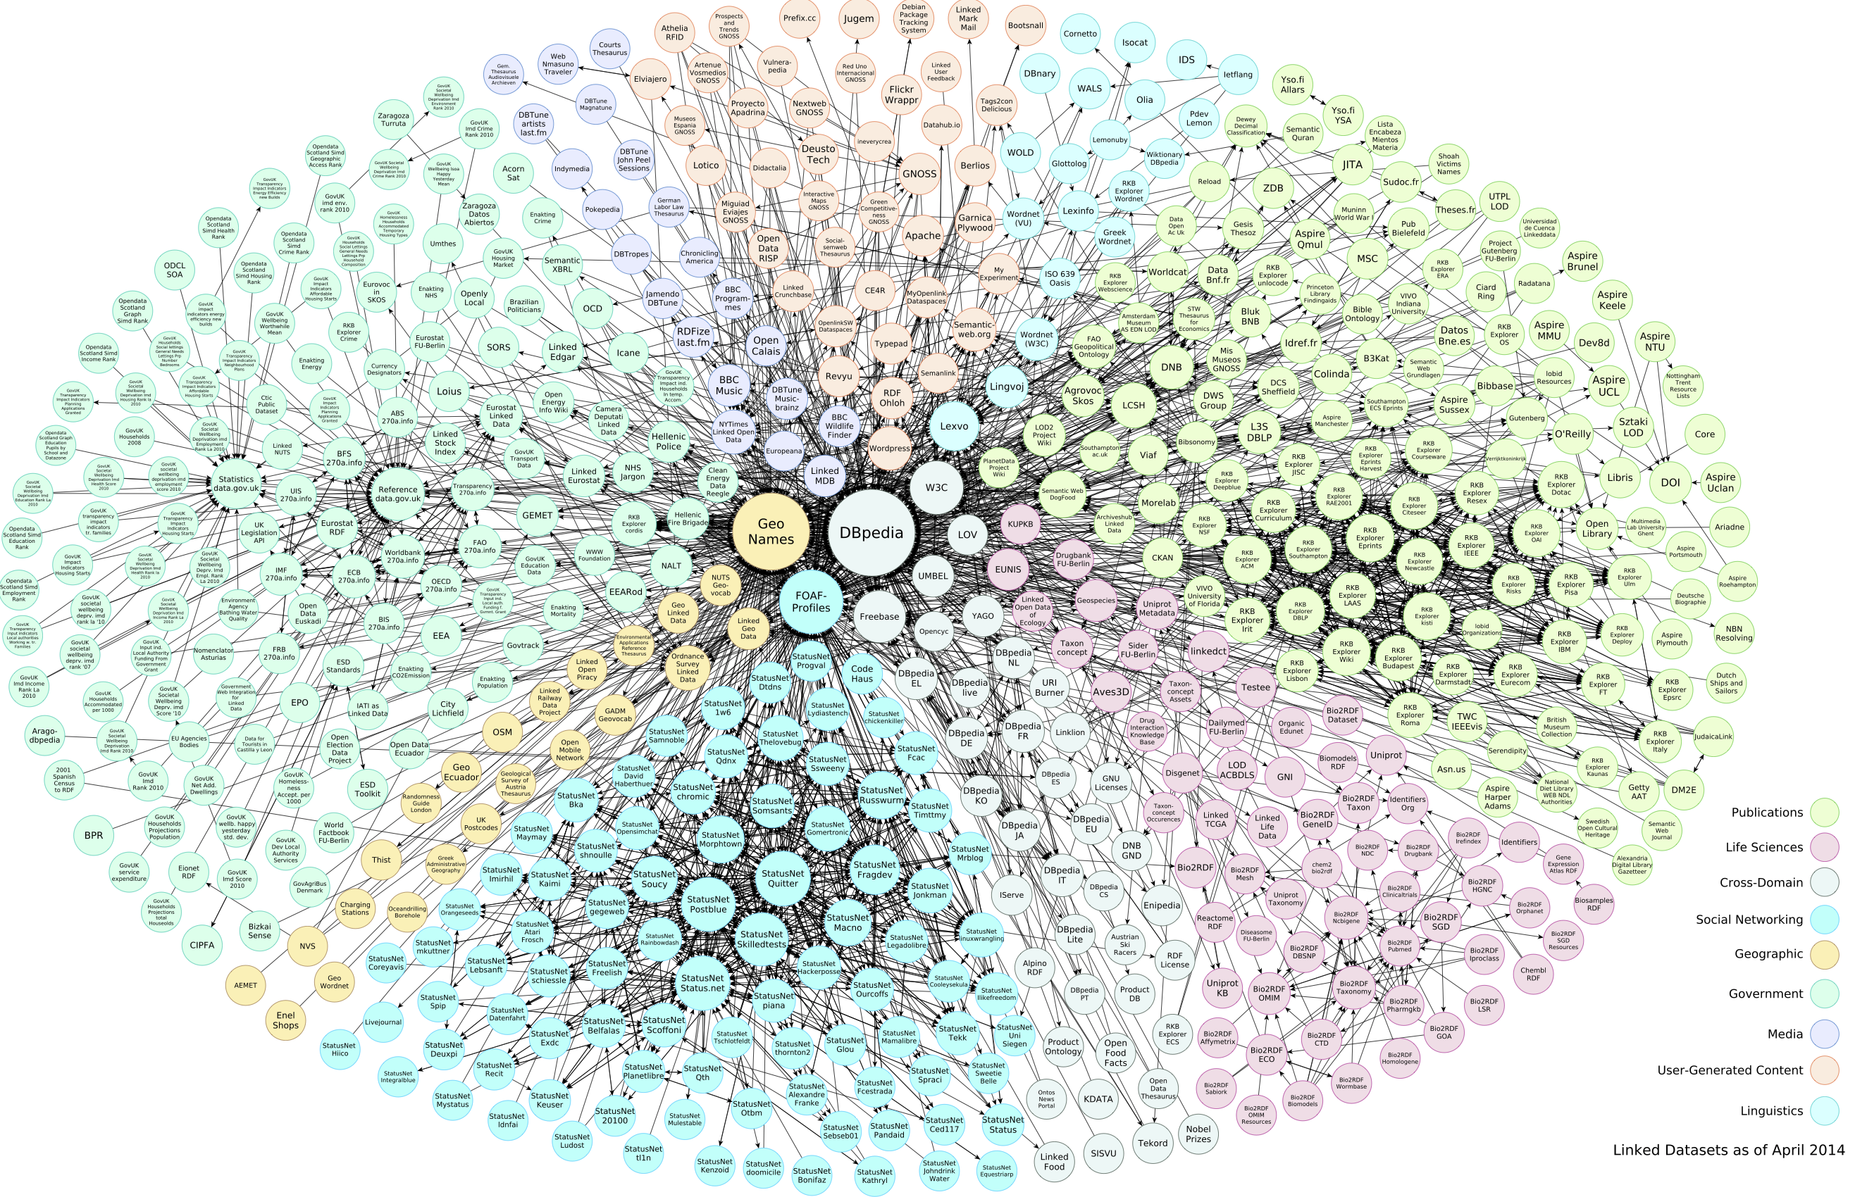
LOD Cloud
LOD Cloud is a mine of data
The heterogeneity of sources reflect directly on the data quality
Finding useful dataset without prior knowledge is increasingly difficult
Demonstrate the of LOD Cloud metadata by running Roomba on the accessible LOD Cloud through datahub.io
What's up LOD Cloud - Observing The State of Linked Open Data Cloud Metadata

Slide 3
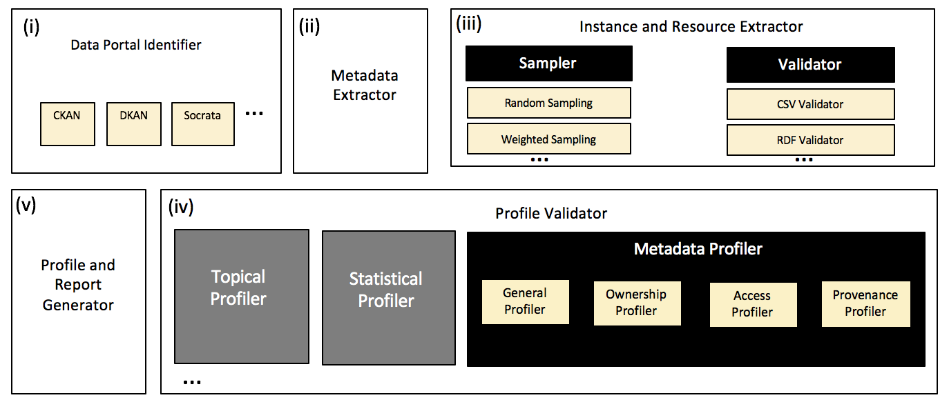
Roomba - An Extensible Framework to Validate and Build Dataset Profiles
Roomba addresses the challenges of automatic validation and generation of descriptive dataset profiles
https://github.com/ahmadassaf/opendata-checker/
Roomba - An Extensible Framework to Validate and Build Dataset Profiles

Slide 5
Conclusion & Future Work
Issues surrounding metadata quality affect directly dataset search in data portals
Roomba enables automatic validation, correction and creation of dataset profiles especially when combined with statistical and topical profilers
We plan to introduce workflows to enable the correction of the rest of the metadata through intuitive, manually-driven interfaces
We also plan to support other data management systems like DKAN and Socrata
Various other enhancements e.g. scheduled reporting
What's up LOD Cloud - Observing The State of Linked Open Data Cloud Metadata

Slide 6
Questions?
Ahmad Assaf
http://ahmadassaf.com
@ahmadaassaf
http://github.com/ahmadassaf
What's up LOD Cloud - Observing The State of Linked Open Data Cloud Metadata

